Slide 1
National primary care reporting: the need for a data model
Jenna Haddin
Primary Health Care Data Development Unit
Australian Institute of Health and Welfare

Slide 2
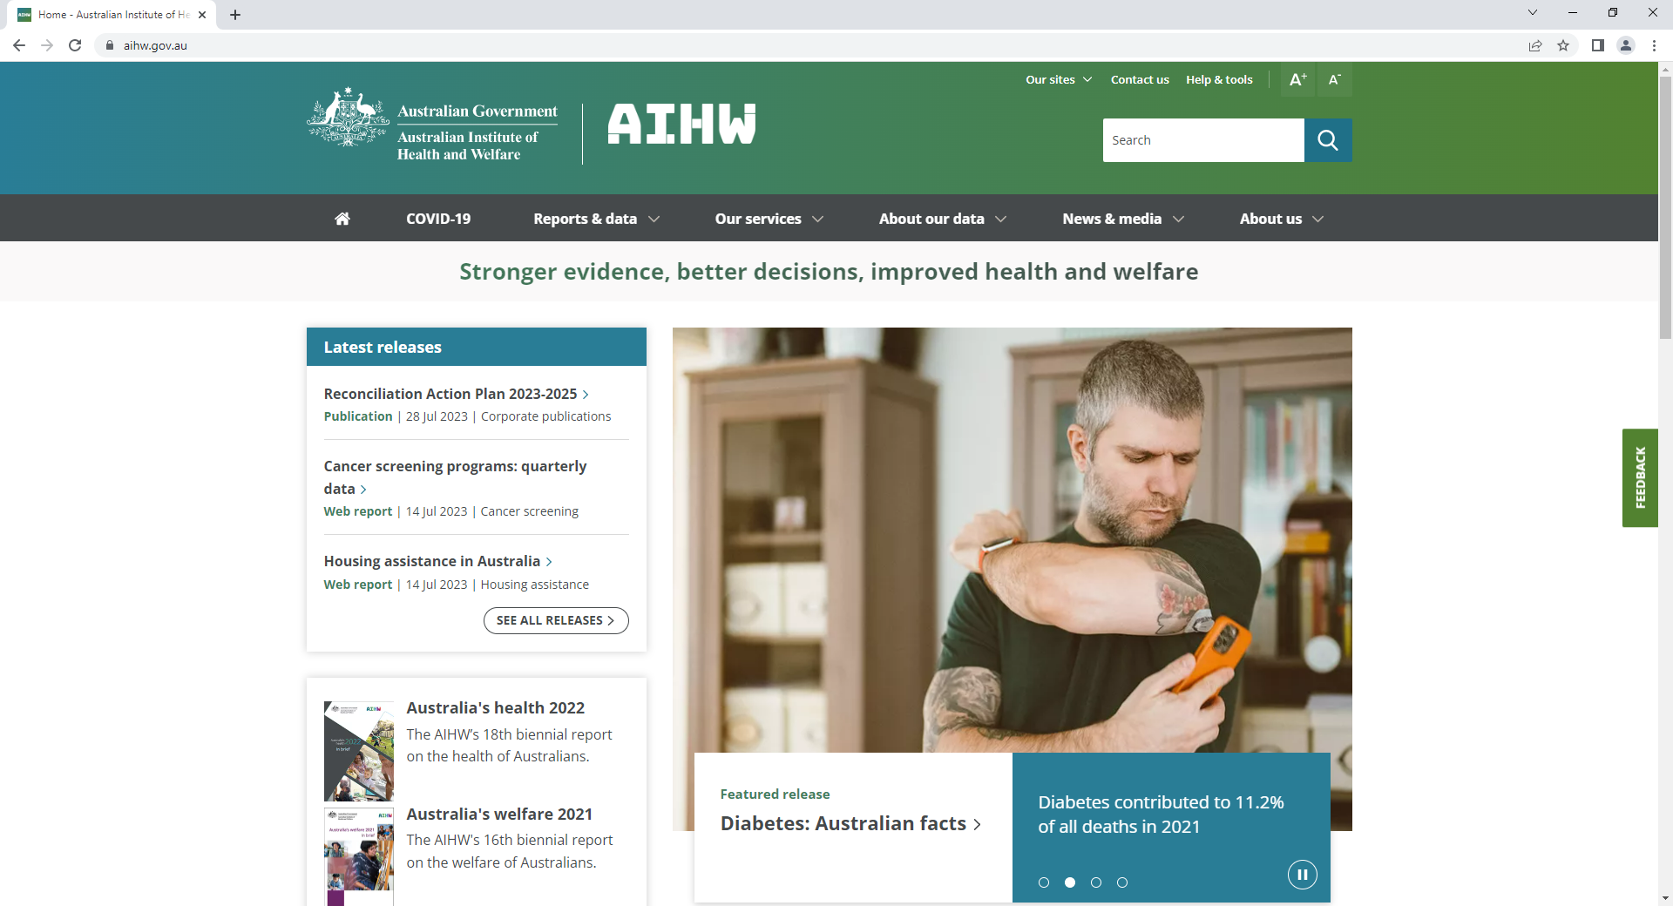
Stronger evidence, better decisions, improved health and wellbeing for all Australians

Slide 3
A focus on data about people

Slide 4
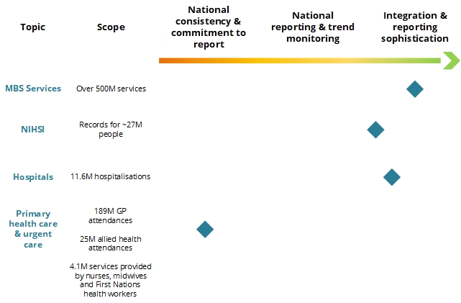
Progress
Data from Australia’s health 2022 https://www.aihw.gov.au/reports-data/australias-health

Slide 5
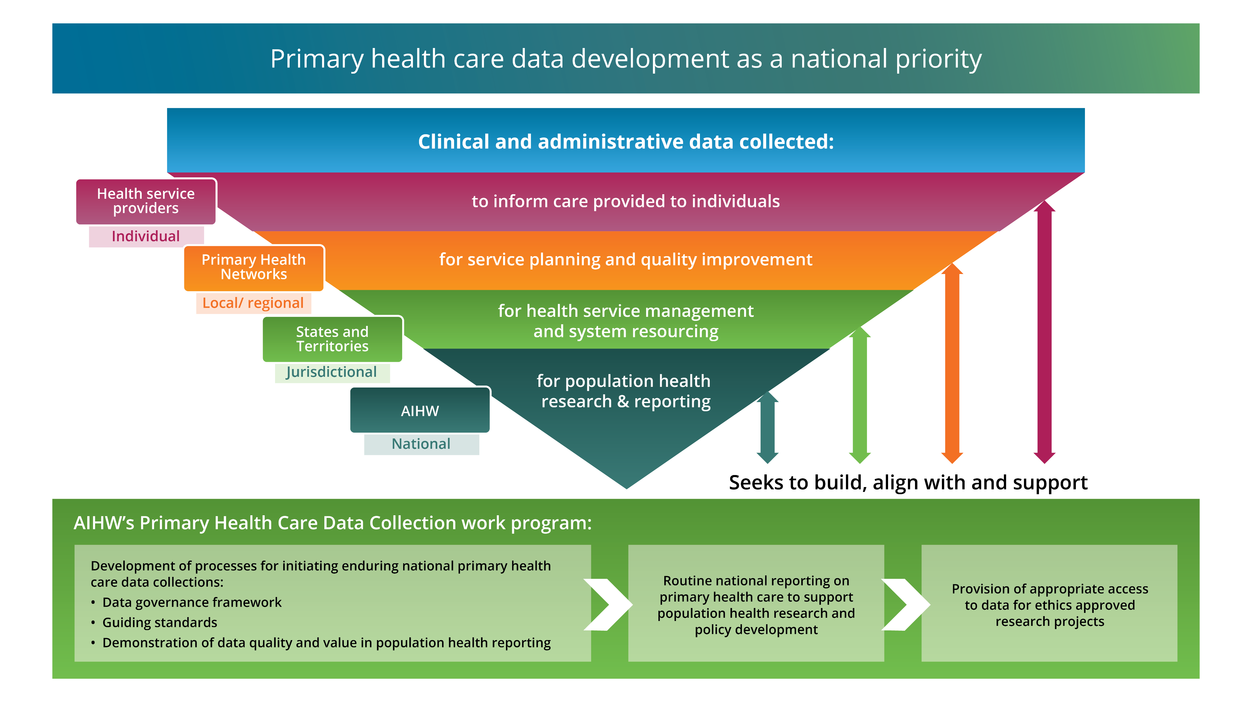
Primary health care data development

Slide 6
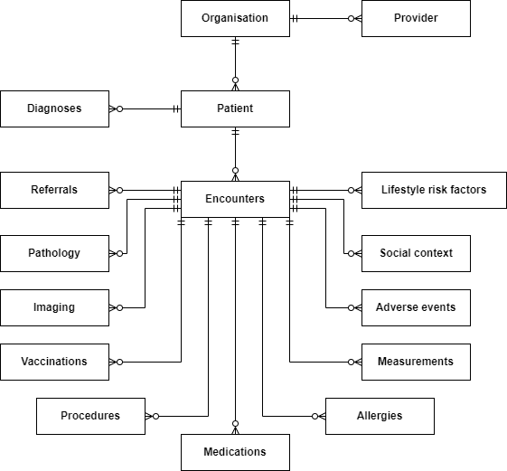
Areas of importance for a primary health care data collection

Slide 7
The need for interoperability
Clinical information systems
(where the data is collected)
Best Practice
Medical Director
ZedMed
Genie
Communicare
PractiX
…
Native terminologies
(how the data is recorded)
Pyefinch
Docle
ICPC-2 PLUS
SNOMED CT
…
Data extraction tools
(how the data is extracted)
Pen CS – CAT4
Outcome Health – POLAR
Primary Sense

Slide 8
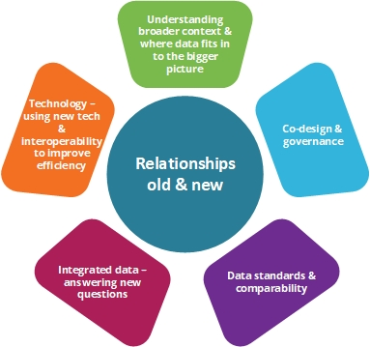
So what?

Slide 9
Thank you
primaryhealthcare@aihw.gov.au

